Slide 1
NYNG Retirement Workshop
NEW YORK NATIONAL GUARD
Transition Assistance Specialist
(TAS)
Larry D. Linville

Slide 2
Benefits
If you have Tricare Reserve Select, it will end the day of your Expiration – Term of Service (ETS).
You can convert to Continued Health Care Benefit Program the Quarterly cost for an individual is approx.. $1,654 and for a family $4,079. (rates are expected to increase in 2023.)
If you have Tricare Dental, it will end the day of your ETS.
Benefeds for vision, it will end the day of your ETS.
VA home loan, require a minimum 6 years of service.
VA Health care coverage, you may not be eligible for VA Health care unless you or service connected through a disability claim. After your compensation is approved, bring your 10-10EZ form or go to the VA to register for VA healthcare.

Slide 3
Benefits
VA Disability Compensation claim. Use a Veteran Service Officer (VSO) to assist you with filing your VA disability claim. VSO’s can be contacted at the; County Veteran Service offices, VFW, American Legion, and DAV. To find a Veteran Service Officer, you can also go to the VA website: www.va.gov
Servicemembers' Group Life Insurance (SGLI) ends 120 days after your ETS.
You may convert to a civilian policy thru the VA website, or you can sign up
for the Veteran’s Group Life Insurance (VGLI).
Family Servicemembers' Group Life Insurance Coverage (FSGLI) is a component of the Servicemembers' Group Life Insurance (SGLI) program. It provides coverage for spouses and children of Servicemembers insured under SGLI. FSGLI ends 120 days after your ETS. You can convert to a civilian policy thru the VA website.

Slide 4
Benefits
Traumatic Service members’ Group Life Insurance (TSGLI) is an addition to the Servicemembers’ Group Life Insurance (SGLI) program that provides traumatically injured service members funds to meet immediate, post-injury financial needs. TSGLI provides a tax-free lump-sum payment as low as $25,000 - up to a maximum of $100,000. ends the day of your ETS date.
Judge Advocate General's Corps, (JAG) to get a power of attorney, wills and medical power of attorneys done.
Survivor Outreach Services (SOS) is available to your family members if anything
happens to you for life. The SOS can assist with determining which benefits your
family members may be entitled to.

Slide 5
Documents
Military Member Documents
Military Records, make sure someone knows where they are kept.
Sections may include: Leave and Earning Statement (LES)/Paystub, Medical, and
your military personnel history. Ex. DD214, NGB 23, LES, and Line of Duty report,
orders
VA Disability status – Make sure your spouse knows if you are receiving VA compensation or in the disability claims process.
Medical Insurance – Tricare eligibility/Civilian.
Dental/Vision Insurance – Tricare eligibility/Civilian.
Survivor Benefit Plan (SBP) – have a copy of that and let significant others know.

Slide 6
Documents
Other Documents (to include family)
Medical Insurance – Civilian/CHAMPVA/Medicare/Medicaid/VA
Dental/Vision – Civilian/VA
Marriage, Birth certificate, Death certificates, Adoption papers, and Divorce Decrees, Social Security card, Medicaid and Medicare cards.
Life insurance policy – list phone and policy numbers, instructions, payments (if payment is monthly, lump sum), company the policy is under, etc.
Legal/Judge Advocate General (JAG) - Updated Will, Power of Attorney (POA), Medical Power of Attorney (POA), Living Will, Guardianship for children/if spouse is incapacitated and Letter of Instructions

Slide 7
Documents
Financial
a. Name of Banks, Credit Unions, etc. (account numbers)
b. List of assets and liabilities (ex. Credit cards, loans and whose name is on them)
c. Safe-Deposit box information
d. 401K/Thrift Savings Plan (TSP)/Investment papers – Ex. TSP if you have thru
military/civilian, cd, bonds etc.
Property and Auto information (home deeds/registrations etc.)
Funeral Instructions (Burial, cremation, memorial service, etc.)
a. Pre-Need Burial Eligibility in a National Cemetery, you can do that now.
Memberships in organizations you are associated with.
Login Id’s and passwords for accounts for all online accounts and those not online.

Slide 8
Documents
Pets: If you have pets, you can do a “pet trust” or you can make provisions in your will for how you wish to have your pets cared for in your absence.
MyPay: As a gray retiree you can have a MyPay account that will keep you informed on benefits and changes that are coming to your benefits. You will be able to track your retirement packet when the time comes.
USA Jobs: make sure you are using an email account other than your military.
Burn Pit Registry: www.publichealth.va.gov burn pit registry and all presumptive conditions. (updated regularly)

Slide 9
NYNG Job Zone
Step 1: Go to https://dmna.ny.gov/
Step 2: Click “Jobs”

Slide 10
Civilian
Step 3: Click “Civilian Job Opportunities”
Click here to see job posting/announcements
https://dmna.ny.gov/jobs/

Slide 11
AGR, Counterdrug, & ADOS
Step 3: Click “AGR, Counterdrug, & ADOS”
Step 4a: Application Instructions for Army Positions
Step 4b: Application Instructions for Air Positions
Click here to see job posting/announcements
https://dmna.ny.gov/jobs/

Slide 12
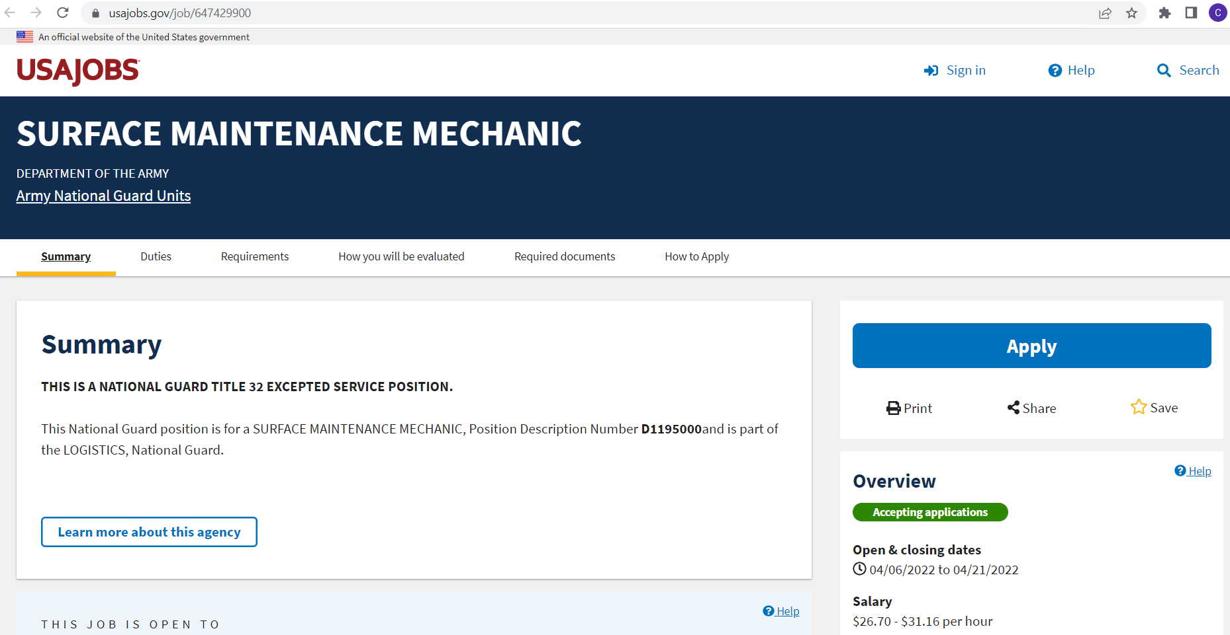
Technician- T32, T5
Step 3: Click “Technician”
https://dmna.ny.gov/jobs/
Step 4: Click on Job Posting, which will redirect you to the job posting on usajobs.gov

Slide 13
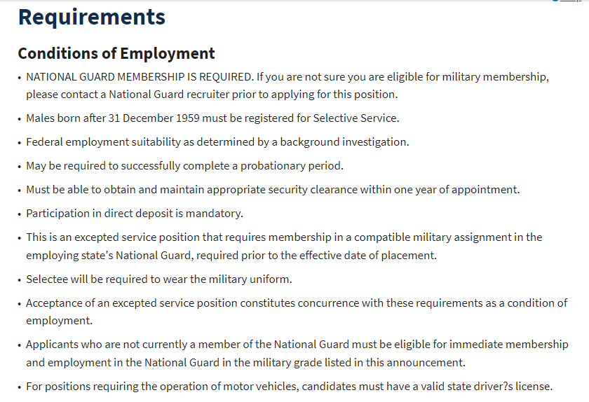
Title 32
Confirm the job is Title 32
Step 5: Click here to “Apply”
Scroll down to the Requirements section for Title 32 Conditions of Employment
https://dmna.ny.gov/jobs/

Slide 14
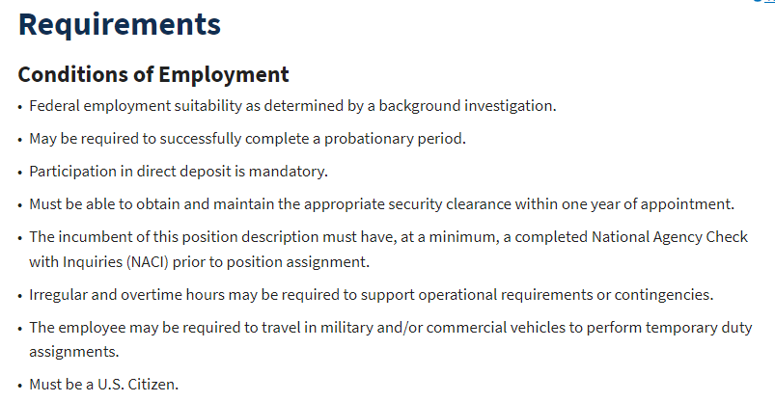
Title 5
Confirm the job is Title 5
Step 5: Click here to “Apply”
Scroll down to the Requirements section for Title 5 Conditions of Employment
https://dmna.ny.gov/jobs/

Slide 15
Technician- Finish Application
Step 6: Once you have completed filling out your application, make sure to click “Finish my application”
https://dmna.ny.gov/jobs/

Slide 16
Good to Know
Register your DD214 with your county office and the Veterans Administration.
Stay current with retirement benefits and entitlements, they most likely will change.
Let your peers know about the retirement workshops, its not OPSEC.
Wherever you chose to keep records and important documents, please share this with those in the need to know!!!

Slide 17
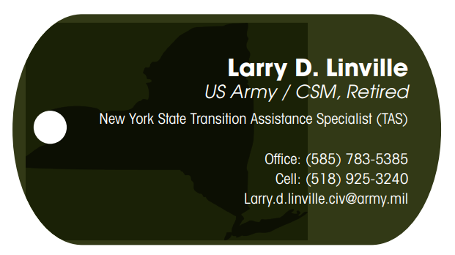
Questions
QUESTIONS?

